Slide 1

Time Complexity & Recursion
Tutorial 2 COMP2521 20T2
Dylan Blecher

Slide 2

Quiz 1 is out!

Slide 3
Assignment 2 is a group assignment

Slide 4

Time Complexity
COMP1511 approach: do it
COMP2521 approach: do it efficiently
How can we measure this?

Slide 5
What is the big-O time complexity?
Program involves “n” operations
O(n)

Slide 6
What is the big-O time complexity?
Program involves “n + 3” operations
O(n)

Slide 7
What is the big-O time complexity?
Program involves “5n² + 4” operations
O(n²)

Slide 8
What is the big-O time complexity?
Program involves “50n² + 2000 + 2n³” operations
O(n³)

Slide 9
What is the big-O time complexity?
Program involves log(n) operations
O(log n)

Slide 10
What is the big-O time complexity?
Program involves 5 operations
O(C)
Note that O(5) = O(1) = O(C)

Slide 11
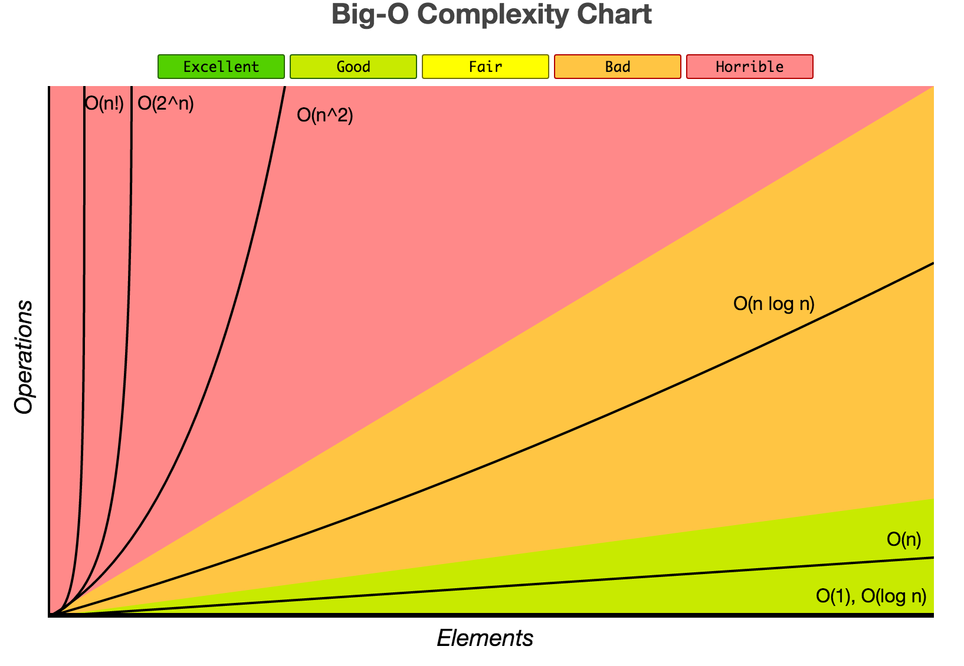
https://www.bigocheatsheet.com/

Slide 12
Recursive Fibonacci

